Slide 1
Chapter 1 – Introduction to Computers and C++ Programming
Outline
1.6 Machine Languages,
Assembly Languages,
and High-Level Languages
1.14 Basics of a Typical C++ Environment
1.19 General Notes About C++ and This Book
1.20 Introduction to C++ Programming
1.21 A Simple Program: Printing a Line of Text
1.22 Another Simple Program: Adding Two Integers
1.23 Memory Concepts
1.24 Arithmetic
1.25 Decision Making: Equality and Relational Operators

Slide 2
1.6 Machine Languages,
Assembly Languages, and High-level Languages
Machine language
  Only language computer directly understands
  Defined by hardware design
    Machine-dependent
  Generally consist of strings of numbers
    Ultimately 0s and 1s
  Instruct computers to perform elementary operations
    One at a time
  Cumbersome for humans
  Example:
For a real example: run “od” on an a.out file.
+1300042774 0100 1101 0111 1101 0001 0100 0001 0110
+1400593419 0101 0011 0111 1011 0101 1100 0000 1011
+1200274027 0100 0111 1000 1010 1011 1010 0110 1011

Slide 3
1.6 Machine Languages,
Assembly Languages, and High-level Languages
Assembly language
  English-like abbreviations representing elementary computer operations
  Clearer to humans
  Incomprehensible to computers
    Translator programs (assemblers)
      Convert to machine language
  Example:
    LOAD BASEPAY
    ADD OVERPAY
    STORE GROSSPAY

Slide 4
1.6 Machine Languages,
Assembly Languages, and
High-level Languages
High-level languages
  e.g. C, C++, BASIC, FORTRAN, Java, Pascal, Ada, Perl
  Use common mathematical notations
  Single statements accomplish substantial tasks
    Assembly language requires many instructions to accomplish simple tasks
  Translator programs (compilers)
    Convert to machine language
  Interpreter programs
    Directly execute high-level language programs
  Example:
    grossPay = basePay + overTimePay

Slide 5
1.14 Basics of a Typical C++ Environment
  C++ Language definition
  Program-development environment (tools)
    compiler, linker, editor, debugger
  C++ Standard Library (software)
    precompiled routines you can use

Slide 6
1.14 Basics of a Typical C++ Environment
Edit
(vi, emacs)
Editor
foo.cpp
Program created in the editor
and stored on disk.
Preprocessor
Preprocessor strips out comments, expands macros
Compile (and Link)
(CC , g++)
foo.o
Compiler
Compiler creates object code and stores it on disk (.o file)
C++ Library
foo
(a.out)
Linker
Linker links the object code with the libraries, stores in a.out on disk.
Loader
Loader puts program
in memory (RAM)
Run
(load and execute)
./foo, ./a.out
.
.
.
.
.
.
CPU
CPU takes each instruction and
executes it, possibly storing
new data values in memory
(RAM) as the program executes.
.
.
.
.
.
.

Slide 7
1.14 Basics of a Typical C++ Environment
Input/output streams in C++
  cin (pronounce “see in”)
    Standard input stream
    Normally keyboard
  cout(pronounce “see out”)
    Standard output stream
    Normally computer screen
  cerr (pronounce “see air”)
    Standard error stream
    Display error messages (normally, screen)
    May be different from cout
    if cout is being directed to a file, for example with
    a.out > foo.dat, or if program is logging errors to a file.

Slide 8
1.19 General Notes About C++ and This Book
Book geared toward novice programmers
  Stress programming clarity
  C and C++ are portable languages
Portability
  C and C++ programs can run on many different computers
Compatibility
  Many features of current versions of C++ not compatible with older implementations

Slide 9
1.20 Introduction to C++ Programming
Structured programming
  Chapters 1-5
Object-oriented programming
  Chapters 6-10
C++ language examples
  Next few slides contain several examples
  Illustrate many important features of C++
  Each analyzed one statement at a time

Slide 10
1.21 A Simple Program:
Printing a Line of Text
Comments
  Document programs
  Improve program readability
  Ignored by compiler
  Single-line comment
    Begin with //
Preprocessor directives
  Processed by preprocessor before compiling
  Begin with #

Slide 11
fig01_02.cpp
(1 of 1) fig01_02.cpp output (1 of 1)
1 // Fig. 1.2: fig01_02.cpp
2 // A first program in C++.
3 #include <iostream>
4
5 // function main begins program execution
6 int main()
7 {
8 std::cout << "Welcome to C++!\n";
9
10 return 0; // indicate that program ended successfully
11
12 } // end function main
Single-line comments.
Function main returns an integer value.
Left brace { begins function body.
Preprocessor directive to include input/output stream header file <iostream>.
Function main appears exactly once in every C++ program..
Statements end with a semicolon ;.
Corresponding right brace } ends function body.
Stream insertion operator.
Name cout belongs to namespace std.
Keyword return is one of several means to exit function; value 0 indicates program terminated successfully.
Welcome to C++!

Slide 12
1.21 A Simple Program:
Printing a Line of Text
Standard output stream object
  std::cout
  “Connected” to screen
  <<
    Stream insertion operator
    Value to right (right operand) inserted into output stream
Namespace
  std:: specifies using name that belongs to “namespace” std
  std:: removed through use of using statements
Escape characters
  \
  Indicates “special” character output

Slide 13
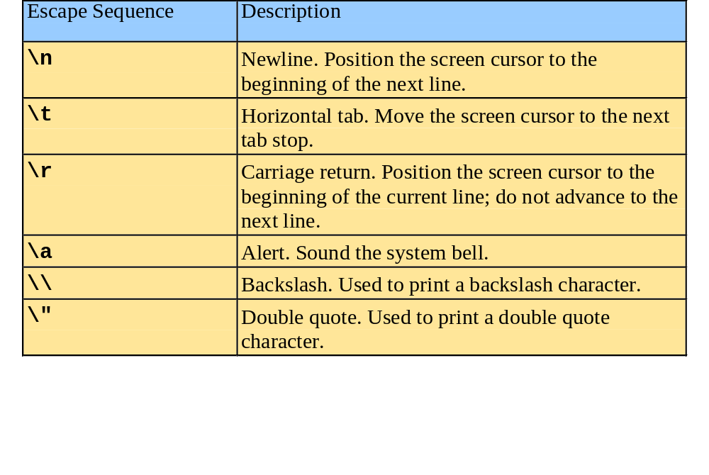
1.21 A Simple Program:
Printing a Line of Text

Slide 14
fig01_04.cpp
(1 of 1) fig01_04.cpp output (1 of 1)
1 // Fig. 1.4: fig01_04.cpp
2 // Printing a line with multiple statements.
3 #include <iostream>
4
5 // function main begins program execution
6 int main()
7 {
8 std::cout << "Welcome ";
9 std::cout << "to C++!\n";
10
11 return 0; // indicate that program ended successfully
12
13 } // end function main
Multiple stream insertion statements produce one line of output.
Welcome to C++!

Slide 15
fig01_05.cpp
(1 of 1) fig01_05.cpp output (1 of 1)
1 // Fig. 1.5: fig01_05.cpp
2 // Printing multiple lines with a single statement
3 #include <iostream>
4
5 // function main begins program execution
6 int main()
7 {
8 std::cout << "Welcome\nto\n\nC++!\n";
9
10 return 0; // indicate that program ended successfully
11
12 } // end function main
Using newline characters to print on multiple lines.
Welcome
to
C++!

Slide 16
1.22 Another Simple Program:
Adding Two Integers
Variables
  Location in memory where value can be stored
  Common data types
    int - integer numbers
    char - characters
    double - floating point numbers
  Declare variables with name and data type before use
    int integer1;
    int integer2;
    int sum;
  Can declare several variables of same type in one declaration
    Comma-separated list
    int integer1, integer2, sum;

Slide 17
1.22 Another Simple Program:
Adding Two Integers
Variables
  Variable names
    Valid identifier
      Series of characters (letters, digits, underscores)
      Cannot begin with digit
      Case sensitive

Slide 18
1.22 Another Simple Program:
Adding Two Integers
Input stream object
  >> (stream extraction operator)
    Used with std::cin
    Waits for user to input value, then press Enter (Return) key
    Stores value in variable to right of operator
      Converts value to variable data type
= (assignment operator)
  Assigns value to variable
  Binary operator (two operands)
  Example:
      sum = variable1 + variable2;

Slide 19
fig01_06.cpp
(1 of 1)
1 // Fig. 1.6: fig01_06.cpp
2 // Addition program.
3 #include <iostream>
4
5 // function main begins program execution
6 int main()
7 {
8 int integer1; // first number to be input by user
9 int integer2; // second number to be input by user
10 int sum; // variable in which sum will be stored
11
12 std::cout << "Enter first integer\n"; // prompt
13 std::cin >> integer1; // read an integer
14
15 std::cout << "Enter second integer\n"; // prompt
16 std::cin >> integer2; // read an integer
17
18 sum = integer1 + integer2; // assign result to sum
19
20 std::cout << "Sum is " << sum << std::endl; // print sum
21
22 return 0; // indicate that program ended successfully
23
24 } // end function main
Declare integer variables.
Use stream extraction operator with standard input stream to obtain user input.
Calculations can be performed in output statements: alternative for lines 18 and 20:
std::cout << "Sum is " << integer1 + integer2 << std::endl;
Stream manipulator std::endl outputs a newline, then “flushes output buffer.”
Concatenating, chaining or cascading stream insertion operations.

Slide 20
fig01_06.cpp output (1 of 1)
Enter first integer
45
Enter second integer
72
Sum is 117

Slide 21
1.23 Memory Concepts
Variable names
  Correspond to actual locations in computer's memory
  Every variable has name, type, size and value
  When new value placed into variable,
  overwrites previous value
  Reading variables from memory is nondestructive

Slide 22
1.23 Memory Concepts
integer1
12
int integer1, integer2, sum;
  declare three variables
  starting values are arbitrary
integer2
0
sum
-3
integer1
45
std::cin >> integer1;
  Assume user entered 45
integer2
0
sum
-3
std::cin >> integer2;
  Assume user entered 72
integer1
45
integer2
72
sum
-3
45
sum = integer1 + integer2;
integer1
integer2
72
sum
117

Slide 23
1.24 Arithmetic
* Multiplication
  / Division
    Integer division truncates remainder
      7 / 5 evaluates to 1
  % Modulus operator returns remainder
      7 % 5 evaluates to 2

Slide 24
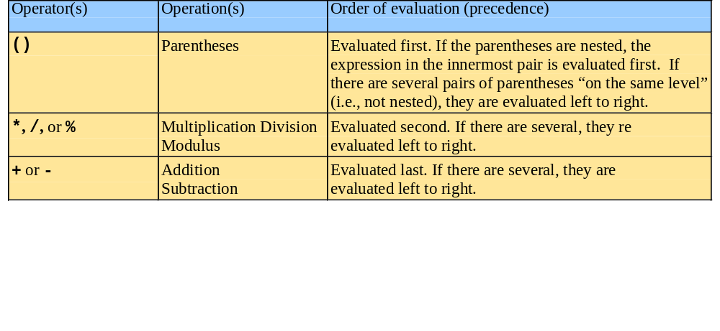
1.24 Arithmetic
Rules of operator precedence
  Operators in parentheses evaluated first
    Nested/embedded parentheses
      Operators in innermost pair first
  Multiplication, division, modulus applied next
    Operators applied from left to right
  Addition, subtraction applied last
    Operators applied from left to right

Slide 25
1.25 Decision Making: Equality and Relational Operators
if structure
  Make decision based on truth or falsity of condition
    If condition met, body executed
    Else, body not executed
Equality and relational operators
  Equality operators
    Same level of precedence
  Relational operators
    Same level of precedence
  Associate left to right

Slide 26
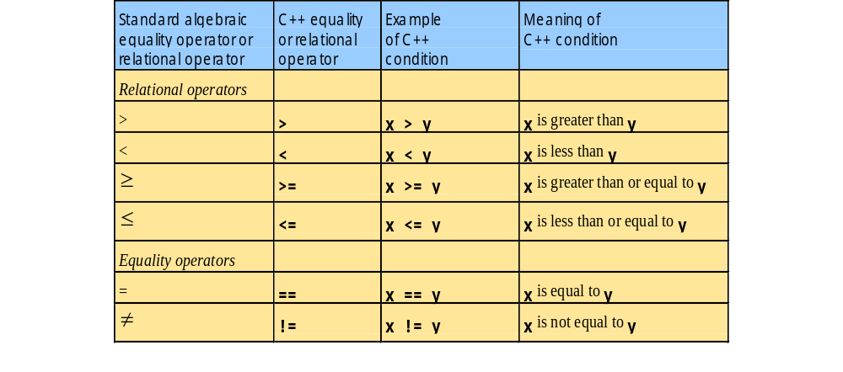
1.25 Decision Making: Equality and Relational Operators

Slide 27
1.25 Decision Making: Equality and Relational Operators
using statements
  Eliminate use of std:: prefix
  Write cout instead of std::cout

Slide 28
fig01_14.cpp
(1 of 2)
1 // Fig. 1.14: fig01_14.cpp
2 // Using if statements, relational
3 // operators, and equality operators.
4 #include <iostream>
5
6 using std::cout; // program uses cout
7 using std::cin; // program uses cin
8 using std::endl; // program uses endl
9
10 // function main begins program execution
11 int main()
12 {
13 int num1; // first number to be read from user
14 int num2; // second number to be read from user
15
16 cout << "Enter two integers, and I will tell you\n"
17 << "the relationships they satisfy: ";
18 cin >> num1 >> num2; // read two integers
19
20 if ( num1 == num2 )
21 cout << num1 << " is equal to " << num2 << endl;
22
23 if ( num1 != num2 )
24 cout << num1 << " is not equal to " << num2 << endl;
25
using statements eliminate need for std:: prefix.
Declare variables.
Can write cout and cin without std:: prefix.
if structure compares values of num1 and num2 to test for equality.
If condition is true (i.e., values are equal), execute this statement.
if structure compares values of num1 and num2 to test for inequality.
If condition is true (i.e., values are not equal), execute this statement.

Slide 29
fig01_14.cpp
(2 of 2) fig01_14.cpp output (1 of 2)
26 if ( num1 < num2 )
27 cout << num1 << " is less than " << num2 << endl;
28
29 if ( num1 > num2 )
30 cout << num1 << " is greater than " << num2 << endl;
31
32 if ( num1 <= num2 )
33 cout << num1 << " is less than or equal to "
34 << num2 << endl;
35
36 if ( num1 >= num2 )
37 cout << num1 << " is greater than or equal to "
38 << num2 << endl;
39
40 return 0; // indicate that program ended successfully
41
42 } // end function main
Statements may be split over several lines.
Enter two integers, and I will tell you
the relationships they satisfy: 22 12
22 is not equal to 12
22 is greater than 12
22 is greater than or equal to 12

Slide 30
fig01_14.cpp output (2 of 2)
Enter two integers, and I will tell you
the relationships they satisfy: 7 7
7 is equal to 7
7 is less than or equal to 7
7 is greater than or equal to 7

